Slide 1
Automata Theory Basics

Slide 2
Alphabet & Language
A letter/symbol is the simplest “building block” of a language
0 & 1 are the only two letters/symbols of binary digits as well as the machine language of a computer
a, b, c, …, z, A, B, …, Z are letters of English language
α, β, … ,ω are letters of Greek language
0, 1, … 9 are letters/symbols of decimal integers
An alphabet Σ is a finite set of letters/symbols
Σ_{B} = {0,1} is the binary alphabet
Σ_{D} = {0,1, …, 9} is the decimal alphabet
Σ_{E} = {a, b, c, …, z} is the lowercase English alphabet
A string is a sequence of letters/symbols
00, 01, 110, 11111, etc. are binary strings
call, boy, toy, etc. are English strings
ε is a special string called empty string (has length 0)

Slide 3
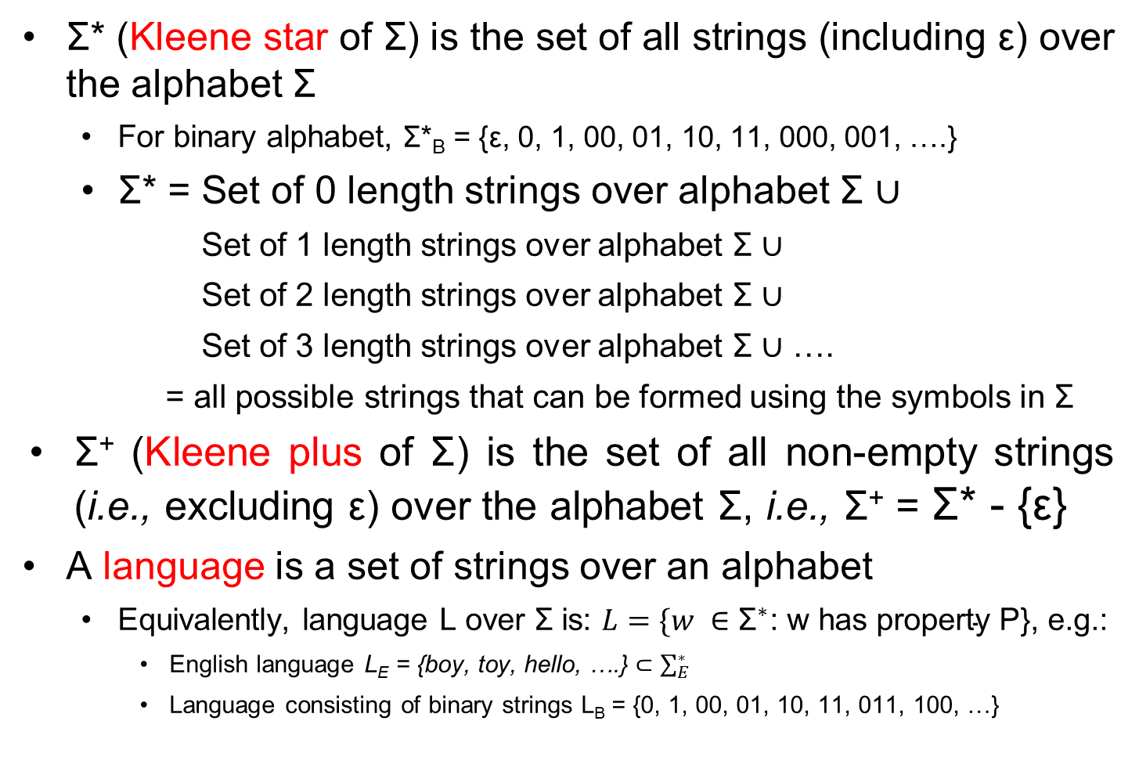
Alphabet & Language
Σ* (Kleene star of Σ) is the set of all strings (including ε) over the alphabet Σ
For binary alphabet, Σ*_{B} = {ε, 0, 1, 00, 01, 10, 11, 000, 001, ….}
Σ* = Set of 0 length strings over alphabet Σ $∪$
Set of 1 length strings over alphabet Σ $∪$
Set of 2 length strings over alphabet Σ $∪$
Set of 3 length strings over alphabet Σ $∪$ ….
= all possible strings that can be formed using the symbols in Σ
Σ⁺ (Kleene plus of Σ) is the set of all non-empty strings (i.e., excluding ε) over the alphabet Σ, i.e., Σ⁺ = Σ* - {ε}
A language is a set of strings over an alphabet
Equivalently, language L over Σ is: $L=\{w ∈{\text{Σ}}^{∗}\text{: }\text{w} \text{has} \text{property} \text{P}\text{\}}$, e.g.:
English language $\text{L}\text{E}\text{ = \{}\text{boy}\text{, }\text{toy}\text{, }\text{hello}\text{, ….\}}⊂\sum_{E}^{∗}{}$
Language consisting of binary strings L_{B} = {0, 1, 00, 01, 10, 11, 011, 100, …}

Slide 4
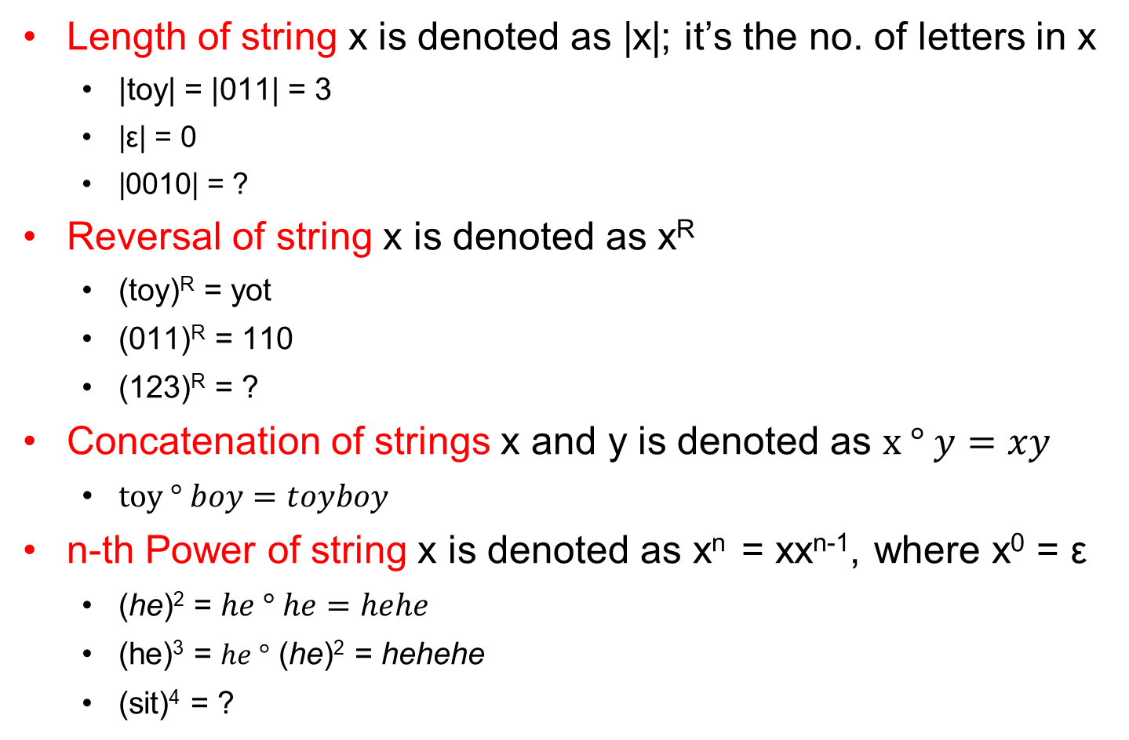
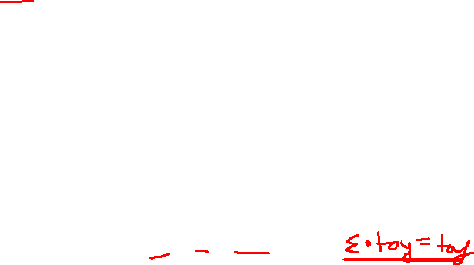
Operations on strings
Length of string x is denoted as |x|; it’s the no. of letters in x
|toy| = |011| = 3
|ε| = 0
|0010| = ?
Reversal of string x is denoted as x^{R}
(toy)^{R} = yot
(011)^{R} = 110
(123)^{R} = ?
Concatenation of strings x and y is denoted as $x ° y=xy$
$toy ° boy=toyboy$
n-th Power of string x is denoted as x^{n} = xx^{n-1}, where x⁰ = ε
(he)² = $he ° he=hehe$
(he)³ = $he °$ (he)² = hehehe
(sit)⁴ = ?

Slide 5
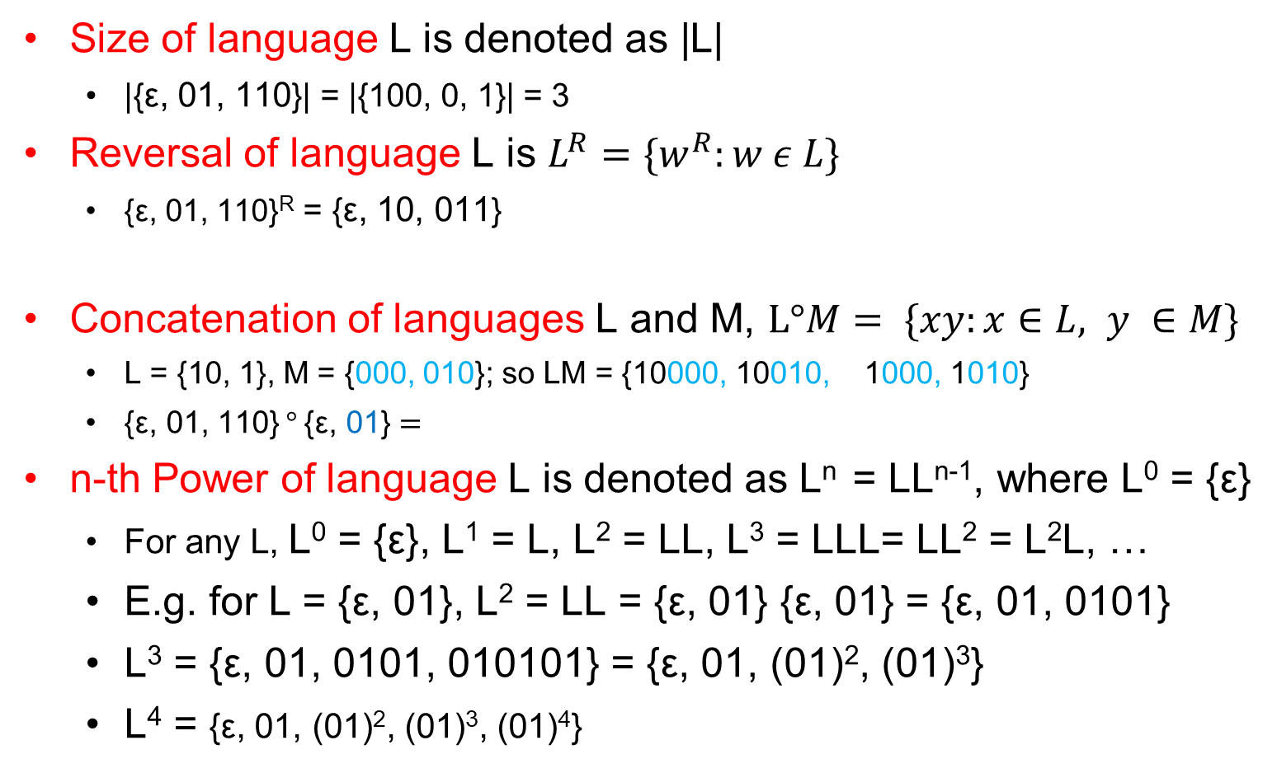

Operations on Language
Size of language L is denoted as |L|
|{ε, 01, 110}| = |{100, 0, 1}| = 3
Reversal of language L is $L^{R}=\{w^{R}:w ε L\}$
{ε, 01, 110}^{R} = {ε, 10, 011}
Concatenation of languages L and M, $L°M= \{xy:x∈L, y ∈M\}$
L = {10, 1}, M = {000, 010}; so LM = {10000, 10010, 1000, 1010}
$\text{\{}\text{ε}\text{, 01, 110\}} ° \text{\{}\text{ε}\text{, }\text{0}\text{1}\text{\}}=$
n-th Power of language L is denoted as L^{n} = LL^{n-1}, where L⁰ = {ε}
For any L, L⁰ = {ε}, L¹ = L, L² = LL, L³ = LLL= LL² = L²L, …
E.g. for L = {ε, 01}, L² = LL = {ε, 01} {ε, 01} = {ε, 01, 0101}
L³ = {ε, 01, 0101, 010101} = {ε, 01, (01)², (01)³}
L⁴ = {ε, 01, (01)², (01)³, (01)⁴}
$\text{\{}\text{ε}\text{, 01, }\text{0101,} \text{110, 11001\}}$
Notes:
ML = {00010, 0001, 01010, 0101}
(LM)^{R}
= {10000, 10010, 1000, 1010}^{R}
= {00001, 01001, 0001, 0101}

Slide 6
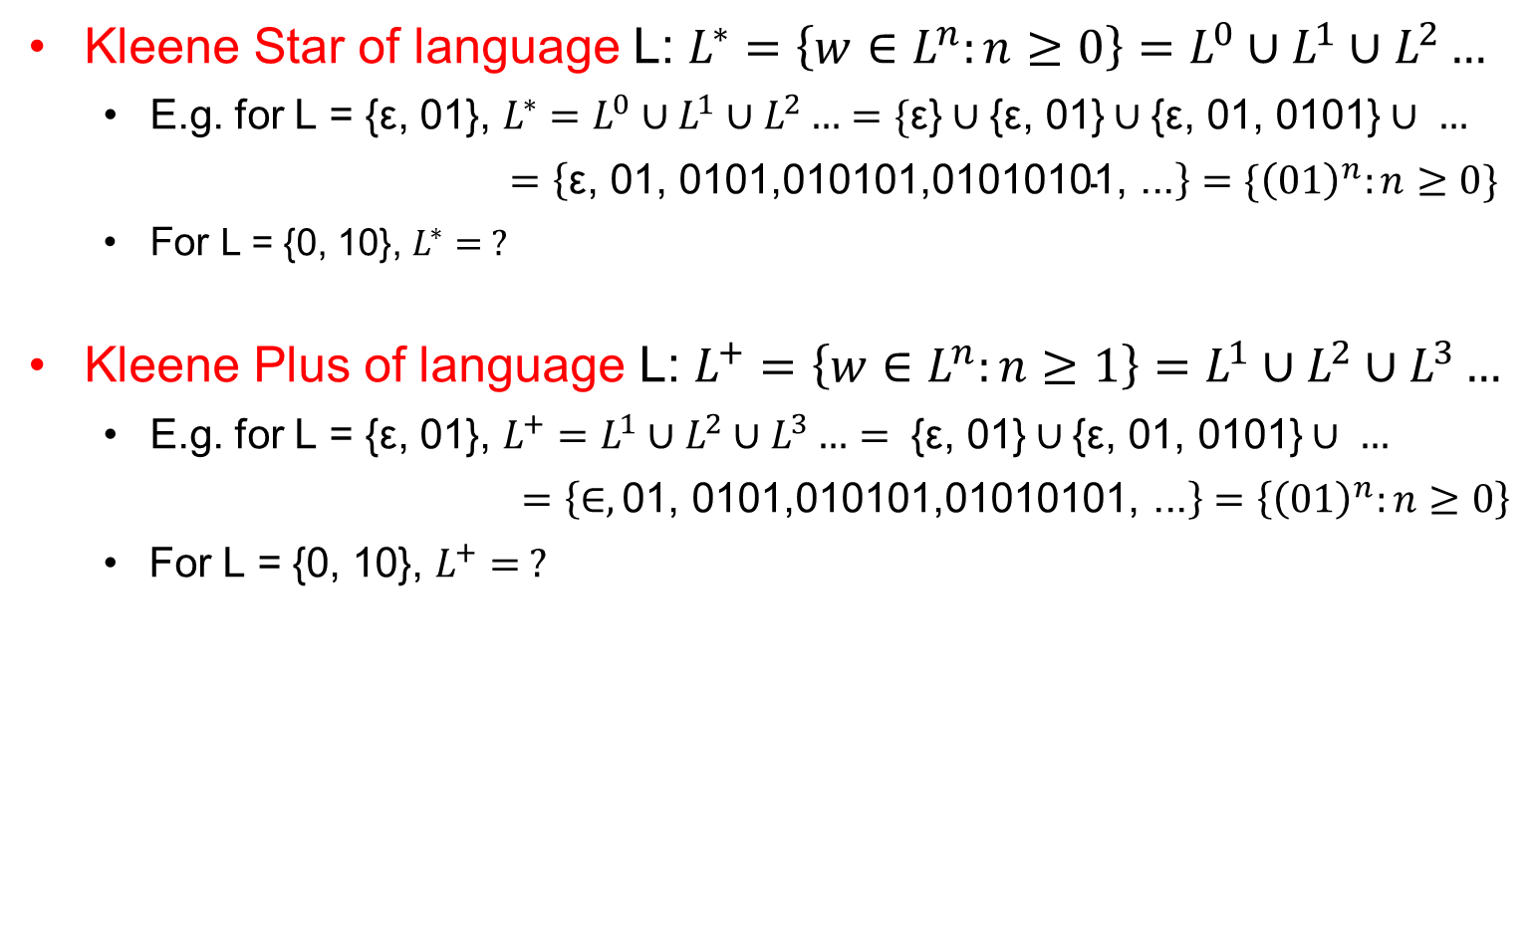
Operations on Language
Kleene Star of language L: $L^{∗}=\left\{w∈L^{n}:n≥0\right\}=L^{0}∪L^{1}∪L^{2}…$
E.g. for L = {ε, 01}, $L^{∗}=L^{0}∪L^{1}∪L^{2}…=\{\text{ε}\text{\}}∪\text{\{}\text{ε}\text{, 01\}}∪\text{\{}\text{ε}\text{, 01, 0101\}}∪ …$
$=\left\{\text{ε}\text{, 01, 0101}\text{,010101,01010101, ...}\right\}=\{{\left(01\right)}^{n}:n≥0\}$
For L = {0, 10}, $L^{∗}= ?$
Kleene Plus of language L: $L^{+}=\left\{w∈L^{n}:n≥1\right\}=L^{1}∪L^{2}∪L^{3}…$
E.g. for L = {ε, 01}, $L^{+}=L^{1}∪L^{2}∪L^{3}…= \text{\{}\text{ε}\text{, 01\}}∪\text{\{}\text{ε}\text{, 01, 0101\}}∪ …$
$=\left\{∈,\text{01, 0101,010101,010101}\text{01}\text{, ...}\right\}=\left\{{\left(01\right)}^{n}:n≥0\right\}$
For L = {0, 10}, $L^{+}= ?$

Slide 7
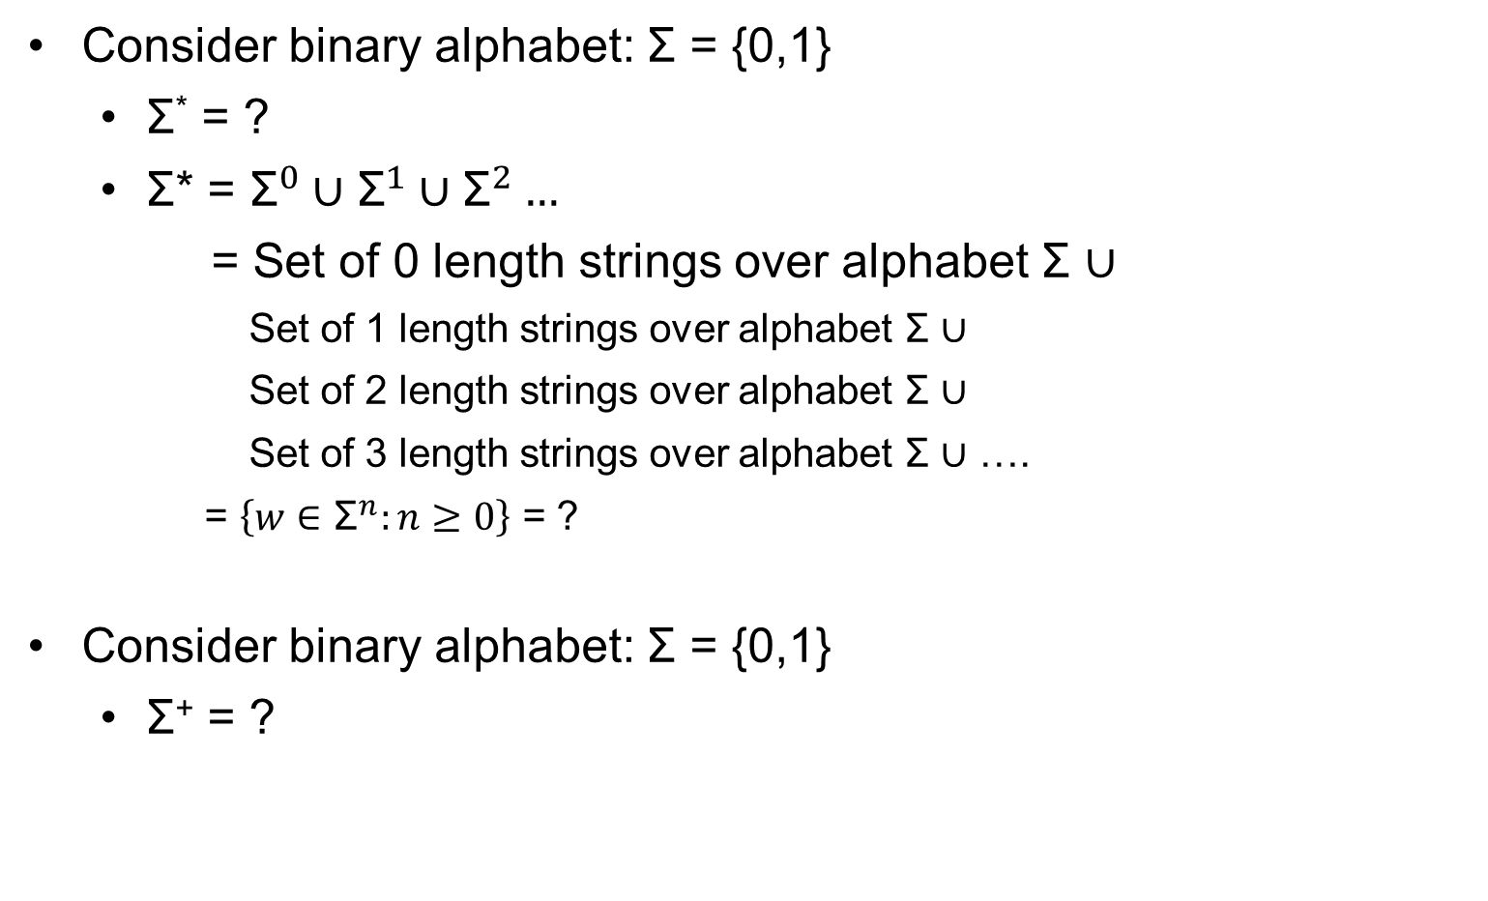
Kleene Star & Kleen Plus of alphabet (revisited)
Consider binary alphabet: Σ = {0,1}
Σ* = ?
Σ* = ${\text{Σ}}^{0}∪{\text{Σ}}^{1}∪{\text{Σ}}^{2}…$
= Set of 0 length strings over alphabet Σ $∪$
Set of 1 length strings over alphabet Σ $∪$
Set of 2 length strings over alphabet Σ $∪$
Set of 3 length strings over alphabet Σ $∪$ ….
= $\left\{w∈{\text{Σ}}^{n}:n≥0\right\}$ = ?
Consider binary alphabet: Σ = {0,1}
Σ⁺ = ?

Slide 8
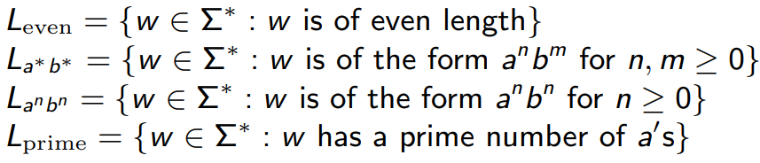
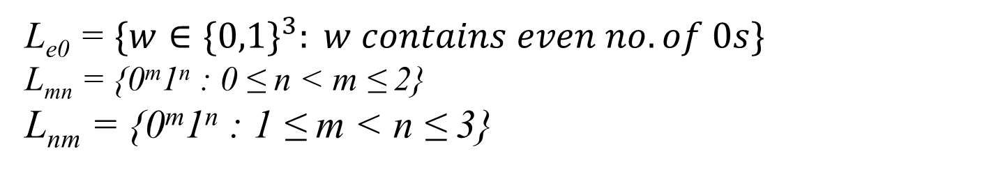
Language Examples
Suppose Σ = {a,b}
Express each of these languages using roaster method:
L_{e0} = $\{w∈\{0,1\}^{3}: w contains even no. of 0s\}$
L_{mn} = {0^{m}1^{n} : 0 ≤ n < m ≤ 2}
L_{nm} = {0^{m}1^{n} : 1 ≤ m < n ≤ 3}

Slide 9
Language Examples
L₁₀₁ = {w in {0,1}* : w ends with 101} = ?
L_{s101} = {w in {0,1}* : w contains 101 as a substring} = ?
L_{nm}L_{mn} = ?
L_{mn}L_{nm} = ?
L_{mn}² = L_{mn} L_{mn} = ?

Slide 10
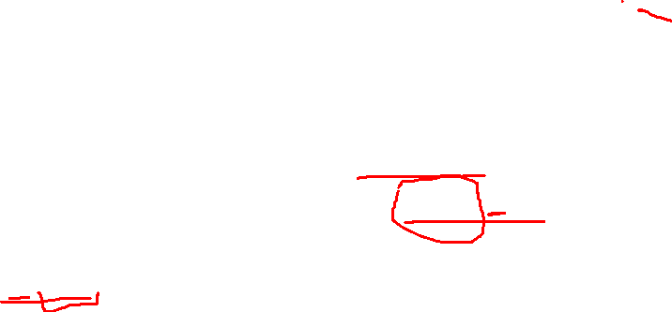
Regular Expression (Intro)
Language of all binary strings
= {0,1}* = {0,1}⁰ U {0,1}¹ U {0,1}² U {0,1}³ U …
= {ϵ} U {0,1} U {00,01,10,11} U {000,001,010,011,100,101,110,111} U ...
Regular Expression (RE) representation of this language is: (0/1)*
Language of all binary strings consisting of only 0s: {0}*
Regular Expression (RE) representation of this language is: 0*
Language of all binary strings which end with 00
= {00, 100, 000, 1000,1100,....} = {0,1}* . {00}
RE representation of this language is: (0 | 1)*00
RE of all binary strings which start with 11 = ?
11 (0/1)*

Slide 11
Regular Expression Definition
A single symbol is a RE, ϵ is also an RE
If x and y are REs then
(i) x*, x⁺, (x) are REs
(ii) xy and x | y are REs
(iii) x^{c} is a RE where c is a positive integer constant
Here | indicates OR operator (+ is also used), and . indicates concatenation operator. Note that we can’t use power in a RE unless the power is a constant
E.g.
(0 | 1)* : RE for all binary strings including ϵ
1(0 | 1)* : RE representing all binary strings which start with 1

Slide 12
Precedence of Operators
Parentheses may be used wherever needed to influence the grouping of operators.
Order of precedence is Kleene * and Kleene + (highest), then concatenation, then | (lowest). Example: 0*1 / 1 == 1 /1, 01/1, 001/1, 0001/1, …

